Slide 1
APNA BHARAT
BUS BOOKING RESERVATION SYSTEM
TECH STACK USED : PYTHON, SQLITE & TKINTER

Slide 2
TABLE OF CONTENTS
01
03
02
04
HOME SECTION
CHECK BOOKED SEAT SECTION
SEAT BOOKING SECTION
ADD BUS DETAILS SECTION

Slide 3
HOME SECTION
01
The Home Section links :-
Seat bookings
View booked seats
Add bus details

Slide 4
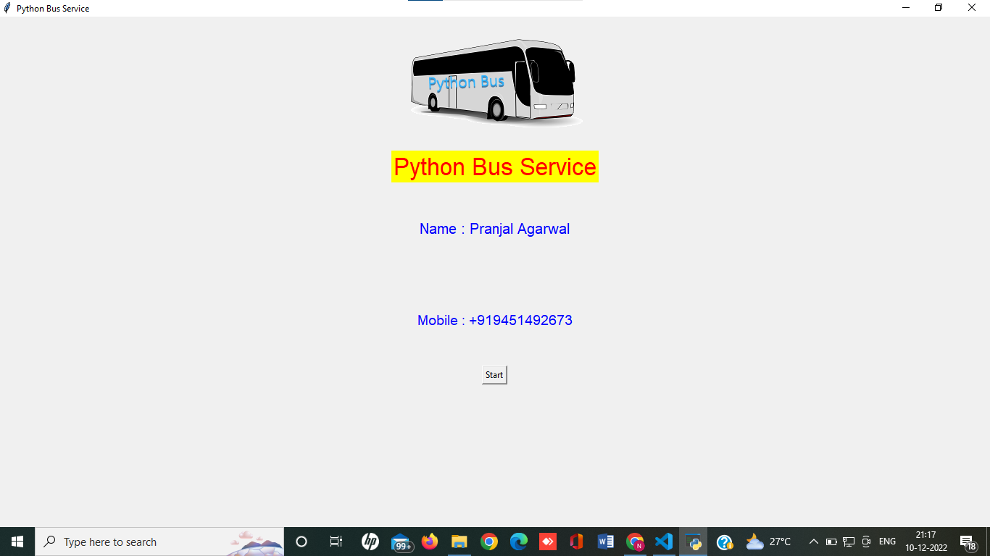
START PAGE

Slide 5
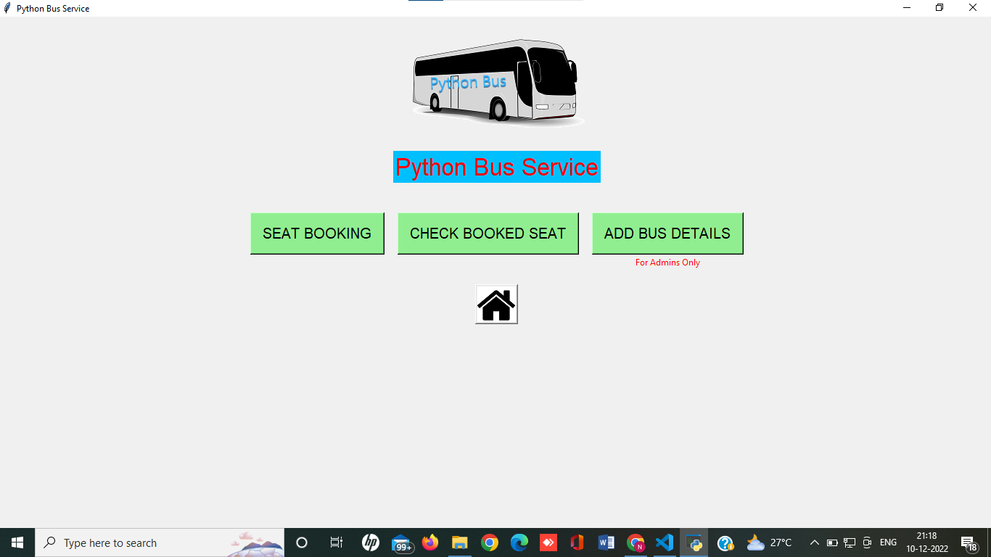
HOME PAGE

Slide 6
SEAT BOOKING SECTION
02
Enter journey details, to check the availability of seats.
Enter your traveling date.
Choose your preferred seat and proceed to enter user details.

Slide 7
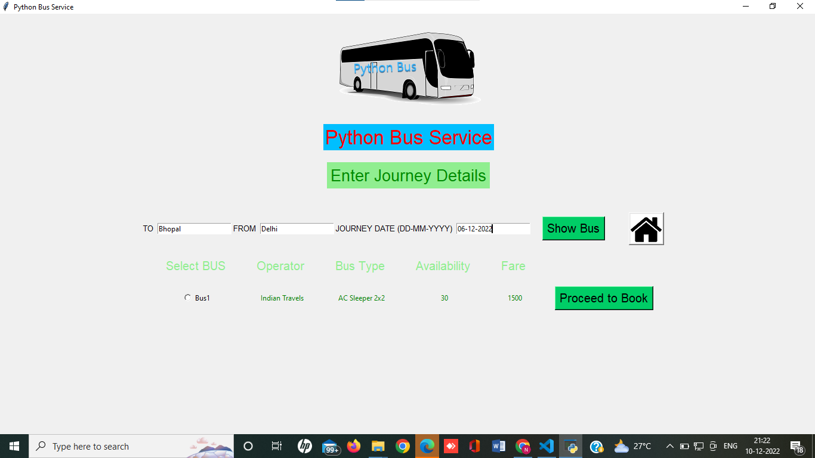
SEAT BOOKING PAGE
Enter Journey Details to View Available Buses
Select Bus to Book

Slide 8
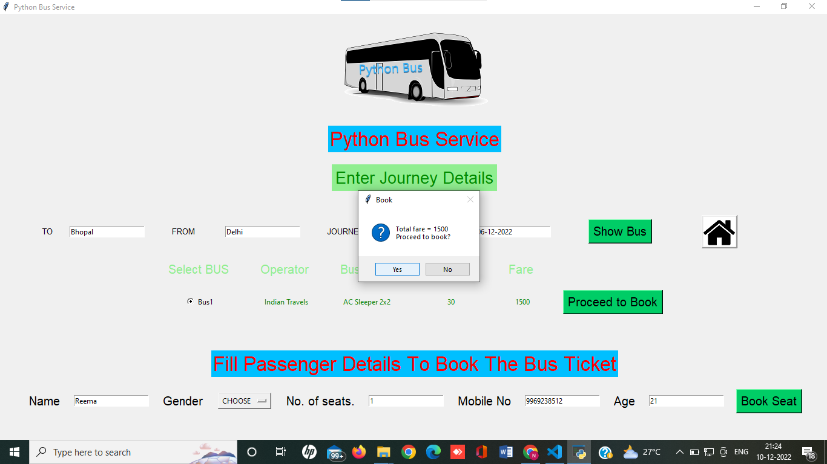
SEAT BOOKING PAGE
Enter Passenger Details and Confirm Booking

Slide 9
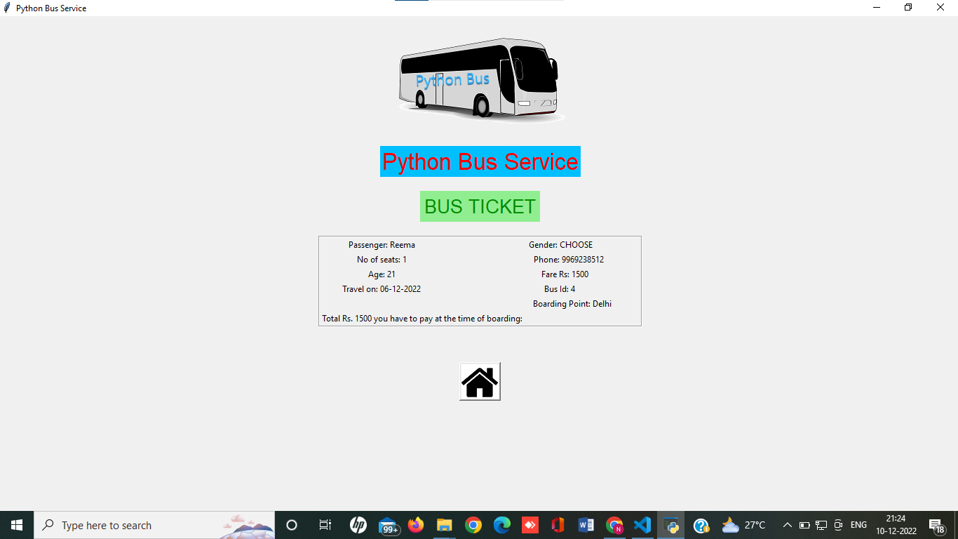
SEAT BOOKING PAGE
View Bus Ticket Details

Slide 10
CHECK BOOKED SEAT SECTION
03
Confirm your tickets through your Phone Number.

Slide 11
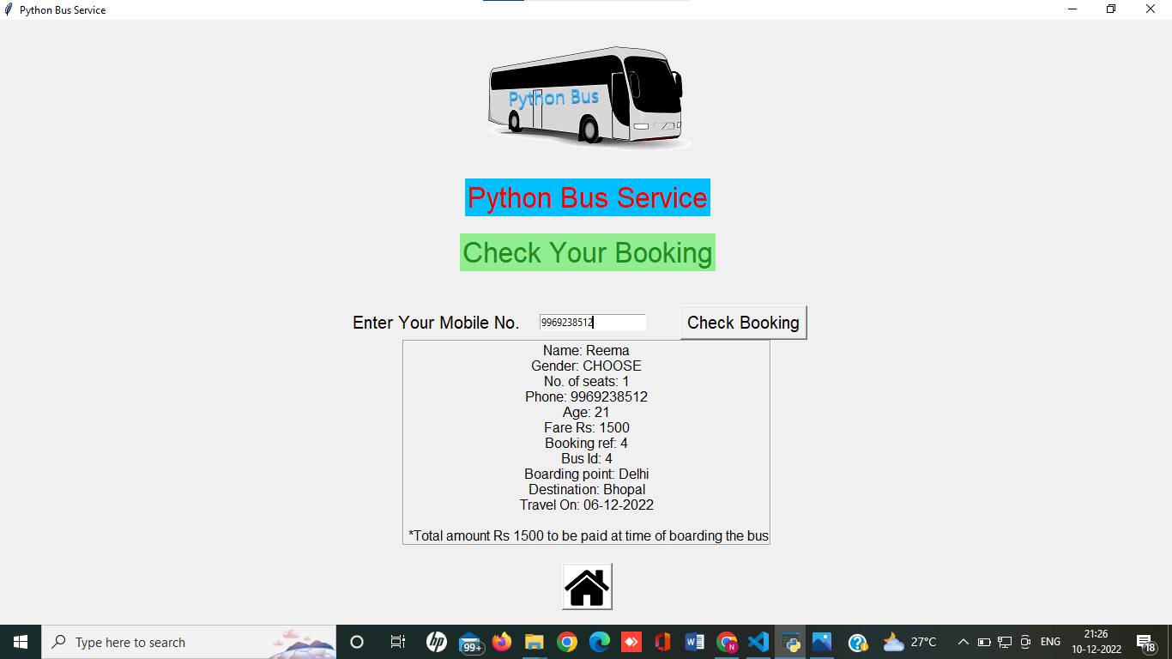
CHECK BOOKED SEAT PAGE
Enter Mobile No. to Check Seat Booking

Slide 12
ADD BUS DETAILS SECTION
04
Admins can add or delete following details:-
Operation Details
Bus type
Bus route
Run time

Slide 13
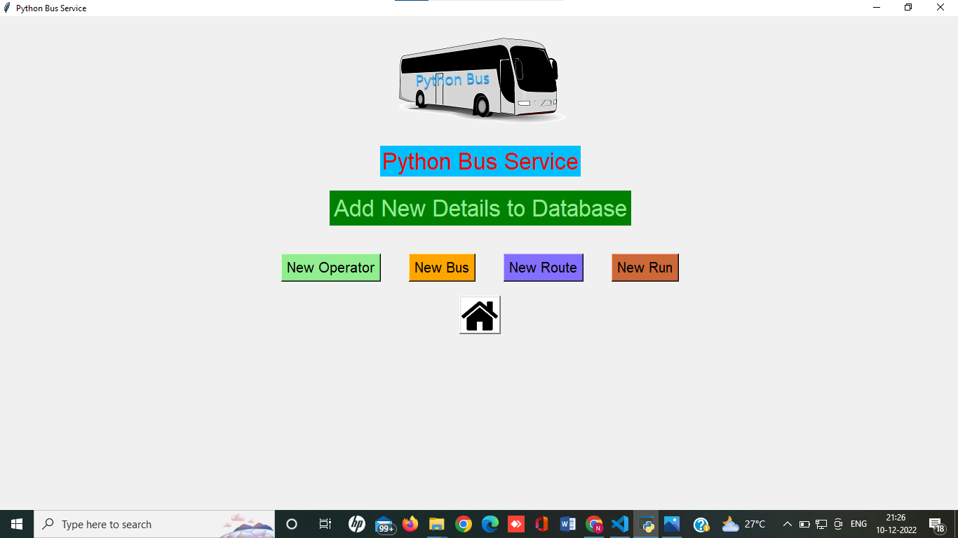
ADD BUS DETAILS PAGE

Slide 14
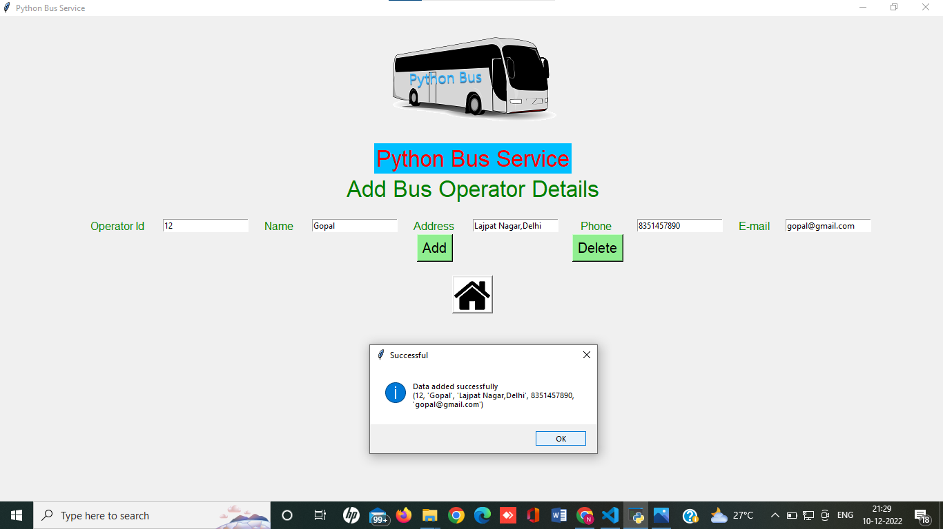
BUS OPERTOR PAGE
Enter Bus Operator Details and Click on Add to Enter

Slide 15
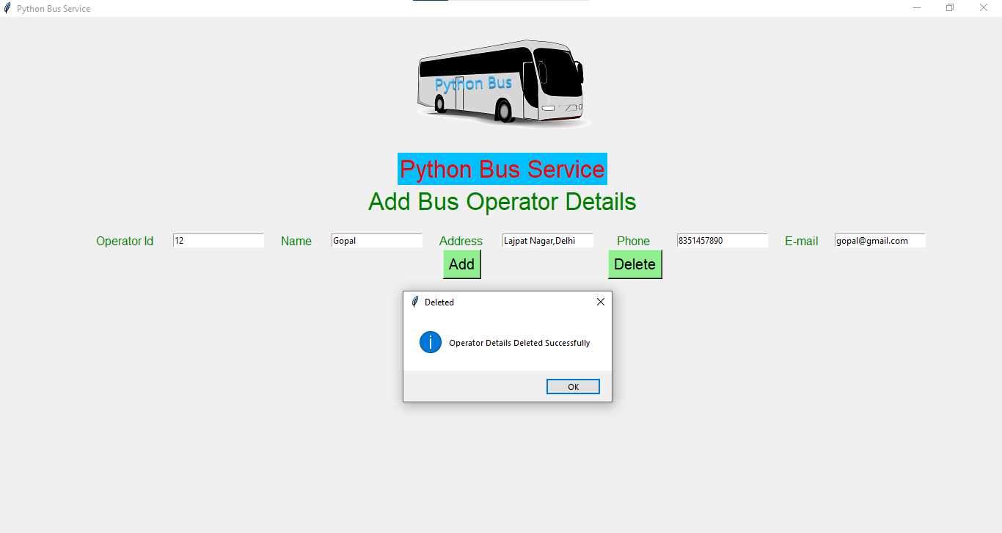
BUS OPERTOR PAGE
Enter Bus Operator Details and Click on Delete to Remove

Slide 16
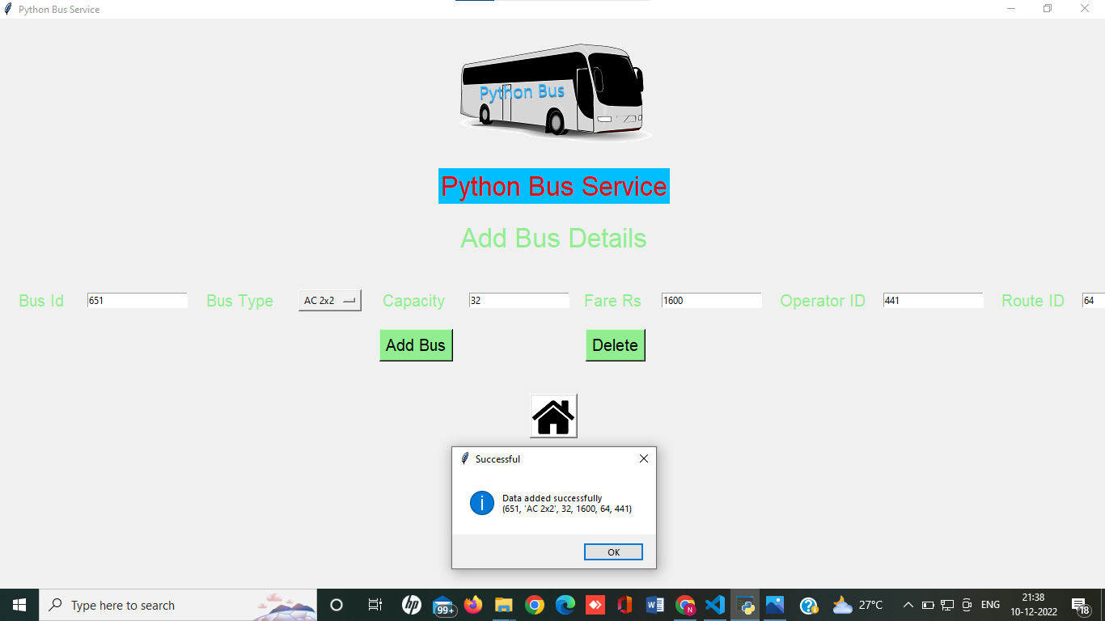
BUS DETAILS PAGE
Enter Bus Details and Click on Add to Enter

Slide 17

BUS DETAILS PAGE
Enter Bus Details and Click on Delete to Remove

Slide 18
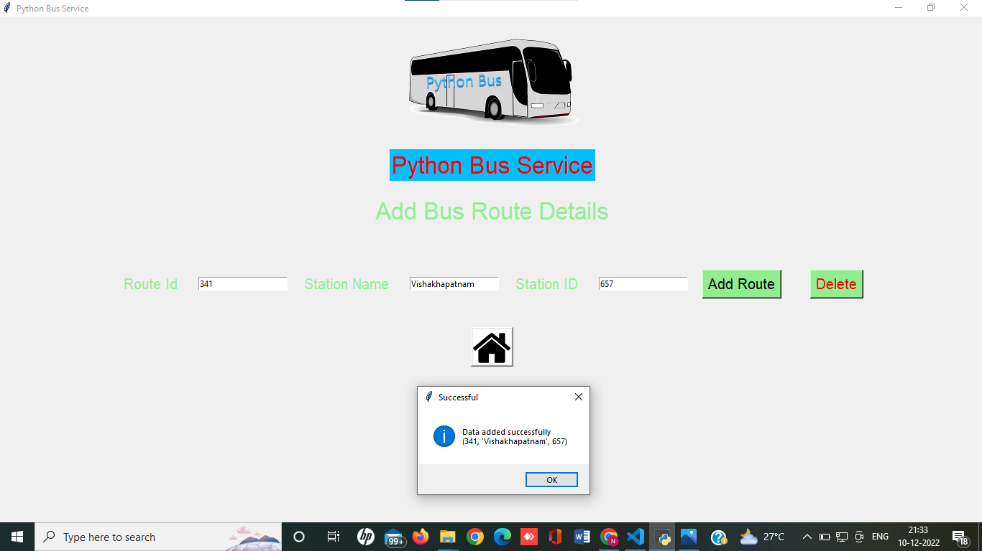
BUS ROUTE PAGE
Enter Bus Route Details and Click on Add to Enter

Slide 19

BUS ROUTE PAGE
Enter Bus Route Details and Click on Delete to Remove

Slide 20
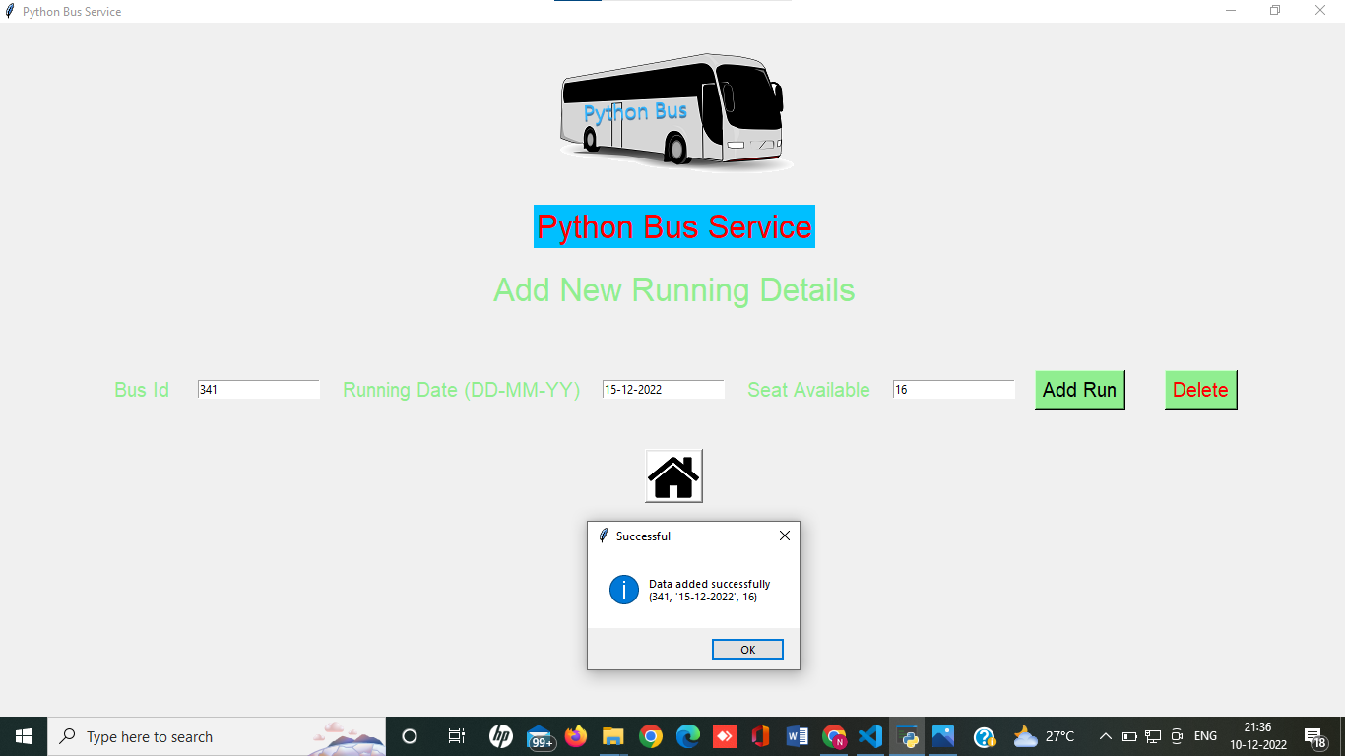
BUS RUNNING PAGE
Enter Running Details and Click on Add to Enter

Slide 21

BUS RUNNING PAGE
Enter Running Details and Click on Delete to Remove

Slide 22
THANK YOU !

